Slide 1



Slide 2











Slide 3



-
-

Slide 4

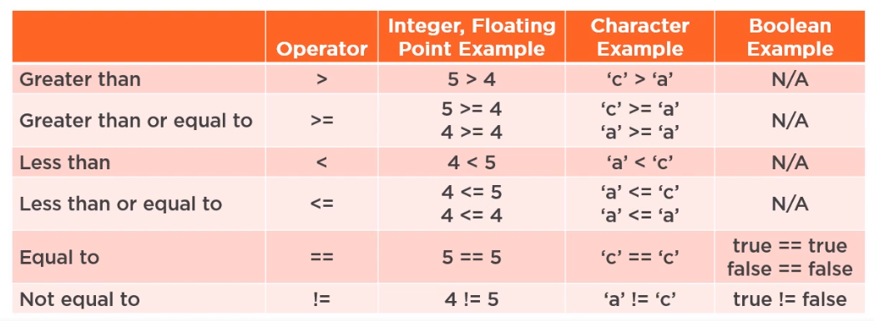

Slide 5
System.out.println(maxValue); // displays 7
int | value1 = | 7;
int | value2 = | 5;
int | maxValue | = value1 > value2 | ? | value1 : | value2 | ;
result =
?
true-value
:
false-value
;

Slide 6




System.out.println(“value 1 is bigger”);
int value1 | = | 10;
int value2 | = | 4;
if (value1 | > | value2)
else
System.out.println(“value 1 is not bigger”);
if ( condition ) true-statement ;
else
false-statement ;
-

Slide 7






-
-
if ( condition-1 ) true-statement-1 ;
else
true-statement-2 ;
.
.
.
else if ( condition-N ) true-statement-N ;
else
false-statement ;
if ( condition-2 )

Slide 8



int value1 | = | 10;
int value2 | = | 40;
if (value1 | > | value2)
System.out.println(“value 1 is bigger”);
else if (value1 < value2)
System.out.println(“value 2 is bigger”);
else
System.out.println(“value 1 and value 2 are equal”);

Slide 9

-
-
-

Slide 10
int a = 20, b = 14, c = 5;
true
true true if ( a > b & b > c )
System.out.println(“a is greater than c”);

Slide 11
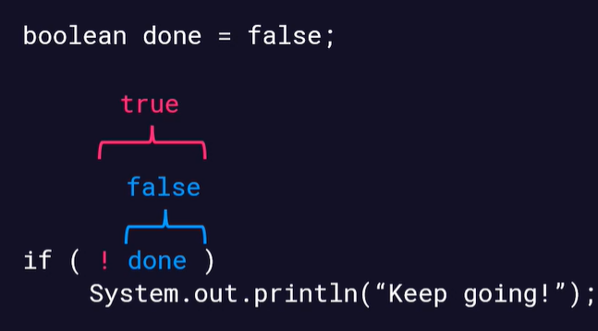

Slide 12

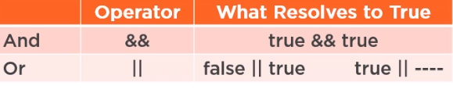
-
-

Slide 13



-
-
-
{
statement-1;
statement-2;
.
.
.
statement-N;
}

Slide 14

int v1 = 10, v2 = 4;
final int diff; if (v1 > v2) {
diff = v1 – v2;
System.out.println(“v1 is bigger than v2, diff = “ + diff);
else {
diff = v2 – v1;
System.out.println(“v1 is not bigger than v2, diff = “ + diff);

Slide 15
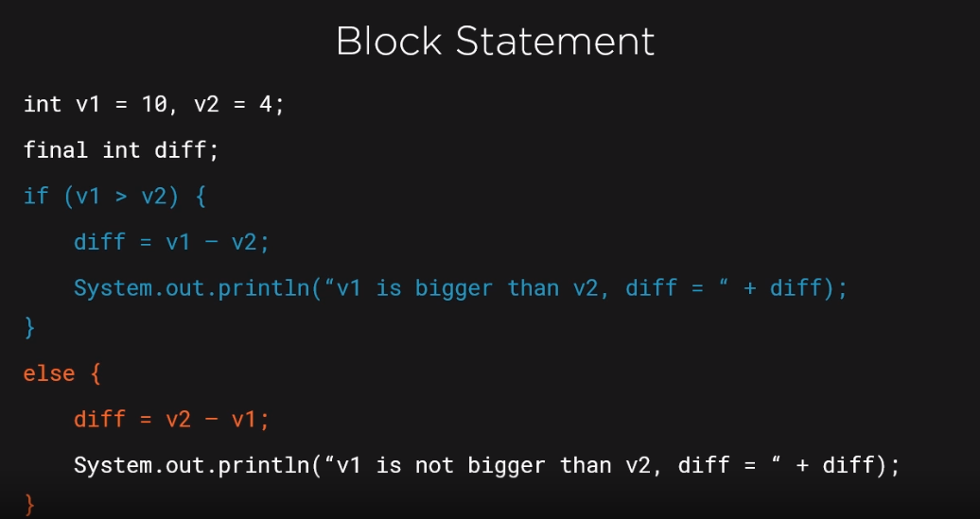

Slide 16



-
-
-

Slide 17


double students = 30.0d, rooms = 4.0d;
if(rooms > 0.0d) { System.out.println(students); System.out.println(rooms); double avg = students / rooms System.out.println(avg);
}
System.out.println(avg);

Slide 18

switch (value-to-test) {
-
-
case matching-value-1:
statements
. break;
.
.
case matching-value-N:
statements
break;
default:
statements
}

Slide 19






Slide 20



-
-
-
-

Slide 21
-
-
-
-

Slide 22
-
-
-
-
-

